Slide 1
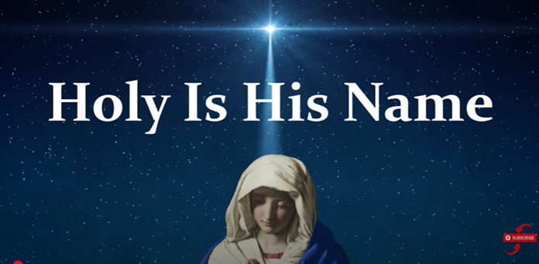

Slide 2
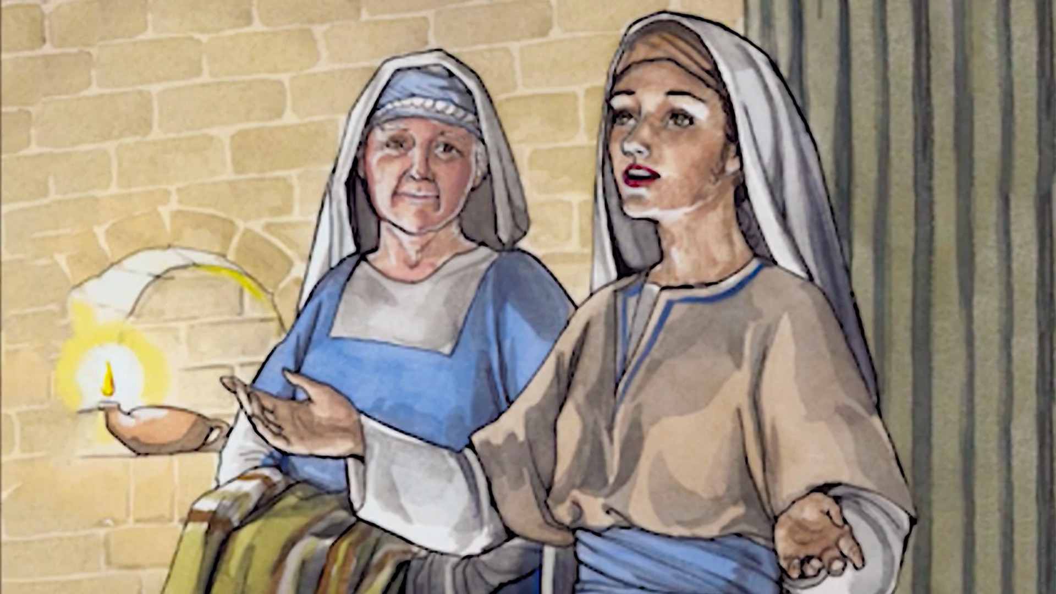
Welcome to our study!
The Magnificat
Luke 1:46-55
Image Copyright Good News Productions International and College Press Publishing

Slide 3
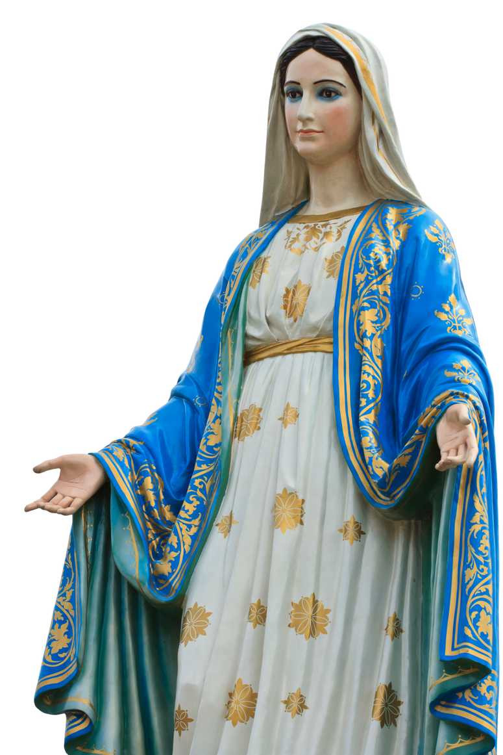
Luke 1:46-55 Mary’s Song
46 And Mary said:
“My soul glorifies the Lord
47 and my spirit rejoices in God my Savior,
48 for he has been mindful
of the humble state of his servant.
From now on all generations will call me blessed,
49 for the Mighty One has done great things for me—
holy is his name.
50 His mercy extends to those who fear him,
from generation to generation.

Slide 4
Luke 1:46-55 Mary’s Song (continued)
51 He has performed mighty deeds with his arm;
he has scattered those who are proud in their inmost thoughts.
52 He has brought down rulers from their thrones
but has lifted up the humble.
53 He has filled the hungry with good things
but has sent the rich away empty.
54 He has helped his servant Israel,
remembering to be merciful
55 to Abraham and his descendants forever,
just as he promised our ancestors.”
.

Slide 5
Session Outline
• Looking at the author (Luke) and setting the Magnificat in context
• Looking at the text – the story, structure, interpretation, similarities to other texts and particularly to 1 Samuel 2:1-10 Hannah’s Prayer
• The revolutionary aspect of the text
• Group discussion
.

Slide 6
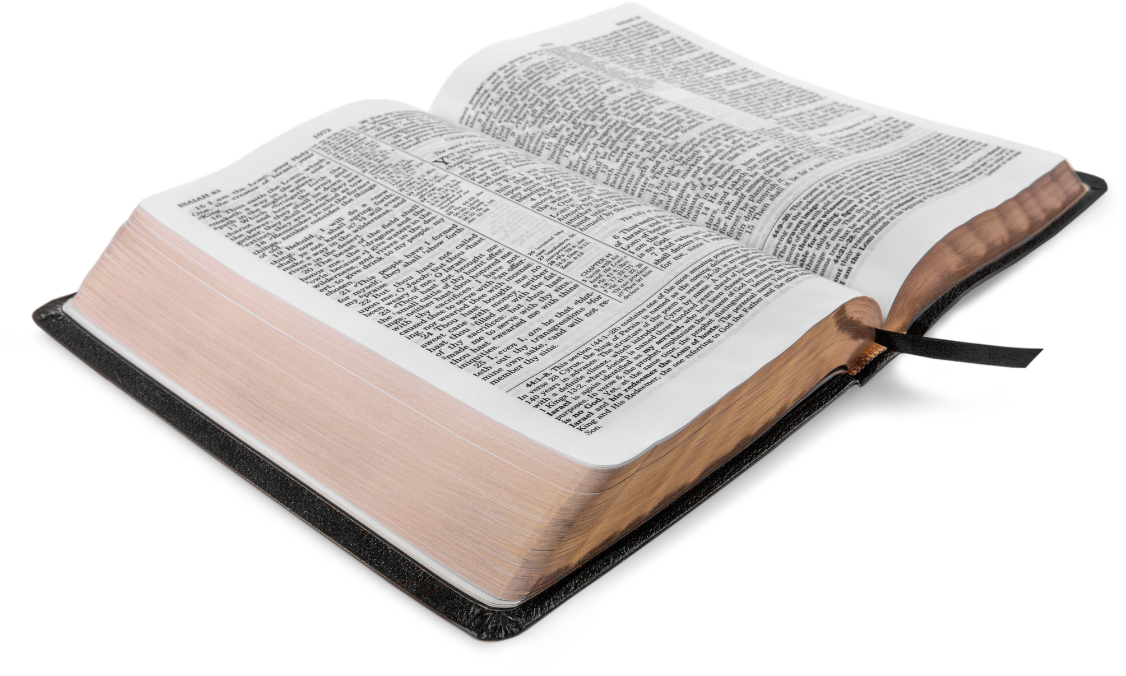
Luke and his Gospel
Not an eyewitness
‘Since many have undertaken to set down an orderly account of the events that have been fulfilled among us, just as they were handed on to us by those who from the beginning were eyewitnesses and servants of the word, I too decided, after investigating everything carefully from the very first, to write an orderly account for you, most excellent Theophilus, so that you may know the truth concerning the things about which you have been instructed.’ (Luke 1:1-4)
.

Slide 7
Luke and his Gospel (contunued)
Gospels ‘were evidence for the teaching of the early Church rather than for Jesus’ own life and work.’
Barton, John, A History of the Bible: The Book and Its Faiths (London: Allen Lane, 2019) Kindle p191
It is believed that Luke wrote his Gospel based on Mark for narrative and a document Q for Jesus’ sayings.
Barton, John, A History of the Bible: The Book and Its Faiths (London: Allen Lane, 2019) Kindle p191
Luke focussed on women in his Gospel showing the inclusivity in Jesus’ teaching.
Burridge, Richard. Four Gospels, One Jesus?: A symbolic reading (SPCK, London 1994). Kindle p120-121
.

Slide 8
Setting the Magnificat in Context – Previous Verses
Luke 1:1-45
‘The scene of Mary’s visit to Elizabeth is Luke’s most obvious affirmation of the way in the two stories of these women are intertwined within the story of God’s redemption.’
Green, Joel, Gospel of Luke (Eerdman, Grand Rapids. MI, 1997) p92

Slide 9
The Magnificat - Luke 1:46-55 'Mary’s Song’
Hymn of Praise
Attridge, Harold W.; Society of Biblical Literature. HarperCollins Study Bible: Fully Revised & Updated (HarperCollins, NY, 2017) Kindle p5825
Similarities with ‘Hannah’s Prayer’ (1 Sam 2.1–10)
Attridge, Harold W.; Society of Biblical Literature. HarperCollins Study Bible: Fully Revised & Updated (HarperCollins, NY, 2017) Kindle p5825
Joy - Mary and Elizabeth, healings, forgiveness and more
Culpepper, R A, New Interpreter’s Bible Vol.IX (Abingdon Press, Nashville,1995) p56
‘A combination of an eschatological hymn and a personal thanksgiving psalm.’ (Schurmann)
Beale & Carson, Commentary on NT use of OT, (Baker Academic, Grand Rapids, 2007) p261
.

Slide 10


The Magnificat - Luke 1:46-55 'Mary’s Song’ (cont)
Divine Reversal – portraying the justice of the Kingdom of God.
Halls, Chris, Lecture 13 Sept 2025 Spiritus Theology College, Magnficat
  Embedded in ourselves
  Films portraying reversal of fortune – the low achieving/the high falling
  Many film endings presenting this.
Can you think of any films or books that portray this?
.

Slide 11
Luke 1:46-55 Similarities to Verses in the OT
Joel Green states:
‘Mary’s Song is a virtual college of Biblical Texts. This not only emphasises its beauty, but also shows how the past can be reemployed to give meaning to the present’
Green, Joel, Gospel of Luke (Eerdman, Grand Rapids. MI, 1997) p101-102
.

Slide 12
Luke 1:46-55 Similarities to Verses in the OT (cont)
49 for the Mighty One has done great things for me - holy is his name
Psalm 126:3 The LORD has done great things for us; we are filled with joy.
Psalm 111:9 He has sent redemption to His people; He has ordained His covenant forever; holy and awesome is His name.
Bible Hub, https://biblehub.com/luke/1-49.htm accessed 1 Oct 2025
.

Slide 13
Luke 1:46-55 Similarities to Verses in the OT (cont)
51 He has performed mighty deeds with his arm; he has scattered those who are proud in their inmost thoughts.
Psalm 89:10 You crushed Rahab like a carcass; You scattered Your enemies with Your mighty arm.
Isaiah 40:10 Behold, the Lord GOD comes with might, and His arm establishes His rule. His reward is with Him, and His recompense accompanies Him
Bible Hub https://biblehub.com/luke/1-51.htm accessed 1 Oct 2025
.

Slide 14
Luke 1:46-55 Similarities to Verses in the OT (cont)
54-55 He has helped his servant Israel, remembering to be merciful to Abraham and his descendants forever, just as he promised our ancestors.”
Genesis 17:19 But God replied, “Your wife Sarah will indeed bear you a son, and you are to name him Isaac. I will establish My covenant with him as an everlasting covenant for his descendants after him.
Bible Hub https://biblehub.com/luke/1-55.htm accessed 1 Oct 2025
.

Slide 15
Structure of Mary’s Song Luke 1:46-55
‘There is no significant action (Mary goes and returns), only dialogue, but the result is a sense of amplitude in a narrative otherwise episodic.’
Johnson, L T, Gospel of Luke (Liturgical Press, Collegeville MN, 1991) p43
Provides a pause
Similar to Psalms containing a word of praise followed by the reasons for this praise – for example Psalm 8, 33, 47, 100, 135, 136
Divine Reversal
Green, Joel, Gospel of Luke (Eerdman, Grand Rapids. MI, 1997) p99
.

Slide 16
Structure of Mary’s Song Luke 1:46-55
Active Verbs
Use of active verbs – reinforces meaning - past tense
‘The effect of this presentation of divine activity is to underscore the decisive work of God, dramatically in operation, and unmistakably in control of human affairs, as the advent of God’s peaceful, just kingdom is realised’
Highlights just how important this text is in terms of Mary having conceived ‘the Son of the Most High.’(verse 32)
Green, Joel, Gospel of Luke (Eerdman, Grand Rapids. MI, 1997) p99
.

Slide 17
Structure of Mary’s Song Luke 1:46-55
Parallelism (NIV translation)
46 (b) “My soul glorifies the Lord
47 and my spirit rejoices in God my Savior,
48 (a) for he has been mindful of the humble state of his servant.
From now on all generations will call me blessed,
49 (a) for the Mighty One has done great things for me
Green, Joel, Gospel of Luke (Eerdman, Grand Rapids. MI, 1997) p99.

Slide 18
Structure of Mary’s Song Luke 1:46-55
Parallelism (NIV translation) continued
51 (a) He has performed mighty deeds with his arm;
51 (b) he has scattered those who are proud in their inmost thoughts.
52 (a) He has brought down rulers from their thrones
52 (b) but has lifted up the humble.
53 (a) He has filled the hungry with good things
53 (b) but has sent the rich away empty.
Green, Joel, Gospel of Luke (Eerdman, Grand Rapids. MI, 1997) p99.

Slide 19
Structure of Mary’s Song Luke 1:46-55
Parallelism (NIV translation) continued
55(a) (merciful/promise) to Abraham and his descendants forever,
55(b) just as he promised our ancestors.
Perhaps clearer in the International Standard Version
55(1) according to the promise he made to our ancestors
55(2) to Abraham and his descendants forever.
We can see the importance of looking at different Bible translations

Slide 20
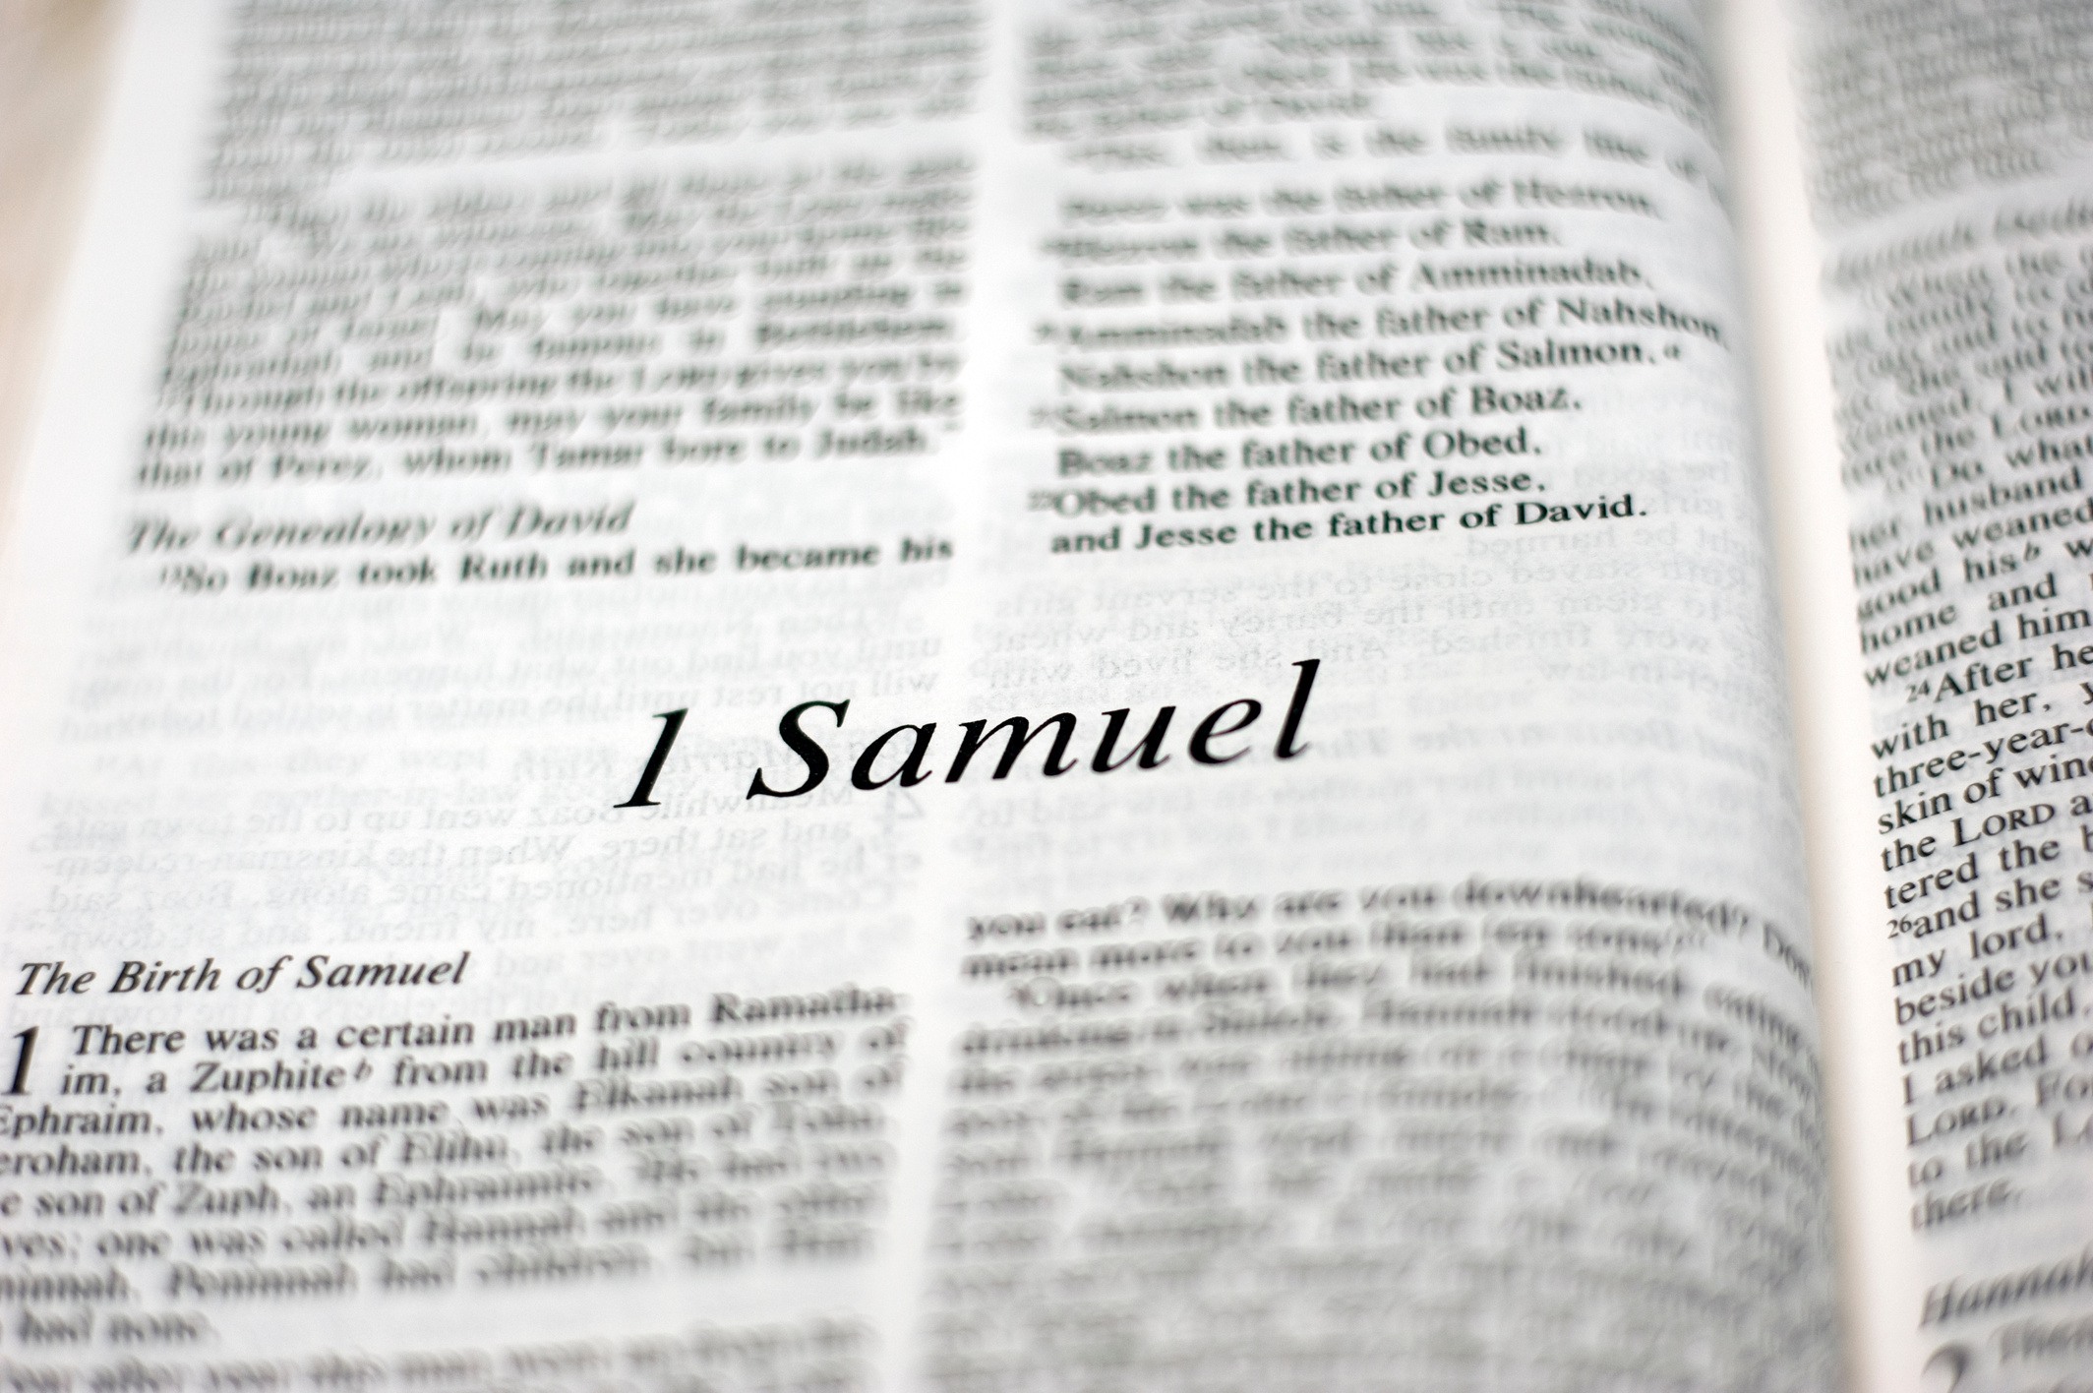
Comparison to 1 Samuel 2.1-10
Both women praise God for the
‘action that he has taken in choosing them to be mothers of instruments of his salvific intervention in Israel’s history
Fitmeyer, Joseph, Gospel According to Luke 1-9 (Doubleday, Garden City, New York,1983) p369

Slide 21
Comparison to 1 Samuel 2.1-10 (continued)
  Mary was probably familiar with the Hebrew Bible and may have used this knowledge, which was further enhanced by Luke.
  We see metaphor, parallelism, metaphor and chiasmus.
  Intertextual – in terms of theological ideas, structure and words.
  Typological – Both women are humble, chosen by God, and give birth to important figures.
Halls, Chris, Lecture 13 Sept 2025 Spiritus Theology College, Magnficat

Slide 22
Comparison to 1 Samuel 2.1-10 (continued)
Praise of God and Joy in Salvation
Luke 1:46-47
46 And Mary said: “My soul glorifies the Lord
47 and my spirit rejoices in God my Savior,
1 Samuel 2:1
1 Then Hannah prayed and said: “My heart rejoices in the Lord;
in the Lord my horn[a] is lifted high.
(a) Horn can be understood as ‘Strength’ and ‘Honour’)
Bible Hub https://biblehub.com/1_samuel/2-1.htm Accessed 4 Oct 2025
Halls, Chris, Lecture 13 Sept 2025 Spiritus Theology College, Magnficat

Slide 23
Comparison to 1 Samuel 2.1-10 (continued)
Status
Both Mary and Hannah are low in status – Mary a poor, unmarried women and Hannah, unable to have children which in her culture would have resulted in scorn.
Divine Reversal and Social Justice
From low to high/high to low.
Halls, Chris, Lecture 13 Sept 2025 Spiritus Theology College, Magnficat

Slide 24
Comparison to 1 Samuel 2.1-10 (continued)
Divine Reversal and Social Justice (cont)
Mary – from poverty, a promise, an unmarried mother - to the birth of the Messiah
‘52 He has brought down rulers from their thrones but has lifted up the humble.
53 He has filled the hungry with good things but has sent the rich away empty. (Luke 1:52-53)
Halls, Chris, Lecture 13 Sept 2025 Spiritus Theology College, Magnficat

Slide 25
Comparison to 1 Samuel 2.1-10 (continued)
Divine Reversal and Social Justice (cont)
Hannah – barren, desperate for a child, she gave birth to Samuel an important prophet for Israel.
7 The Lord sends poverty and wealth; he humbles and he exalts.
8 He raises the poor from the dust and lifts the needy from the ash heap;
he seats them with princes and has them inherit a throne of honor.’ (1 Samuel 2:7-8)
Halls, Chris, Lecture 13 Sept 2025 Spiritus Theology College, Magnficat

Slide 26
Comparison to 1 Samuel 2.1-10 (continued)
Faithful to the Covenant
Mary – ‘55 to Abraham and his descendants forever, just as he promised our ancestors.’
Hannah – ‘.. 10 He will give strength to his king..’
Halls, Chris, Lecture 13 Sept 2025 Spiritus Theology College, Magnficat

Slide 27
Magnificat – the most revolutionary of Advent hymns
“The song of Mary is the oldest Advent hymn. It is at once the most passionate, the wildest, one might even say the most revolutionary Advent hymn ever sung. This is not the gentle, tender, dreamy Mary whom we sometimes see in paintings.…This song has none of the sweet, nostalgic, or even playful tones of some of our Christmas carols. It is instead a hard, strong, inexorable song about the power of God and the powerlessness of humankind.”
Dietrich Bonhoeffer Sermon during Advent 193
Halls, Chris, Lecture 13 Sept 2025 Spiritus Theology College, Magnficat
What do you think of Bonhoeffer’s statement?

Slide 28

Group Discussion

Slide 29
Questions
Do you think Mary would see her role this as a blessing or a burden?
How do you feel when you read Luke 8:19-21 below?
19 Now Jesus’ mother and brothers came to see him, but they were not able to get near him because of the crowd. 20 Someone told him, “Your mother and brothers are standing outside, wanting to see you.”
21 He replied, “My mother and brothers are those who hear God’s word and put it into practice.” (Luke 8:19-21)

Slide 30
Blessing - On Waking
I give thanks for arriving
Safely in a new dawn,
For the gift of eyes
To see the world,
The gift of mind
To feel at home
In my life.
The waves of possibility
Breaking on the shore of dawn,
The harvest of the past
That awaits my hunger,
And all the furtherings
This new day will bring.
Amen
O’Donohue, John, Benedictus - a Book of Blessings (Transworld Digital, Ireland, 2009) Kindle p101

Slide 31
Thank you for joining us today

